Slide 1
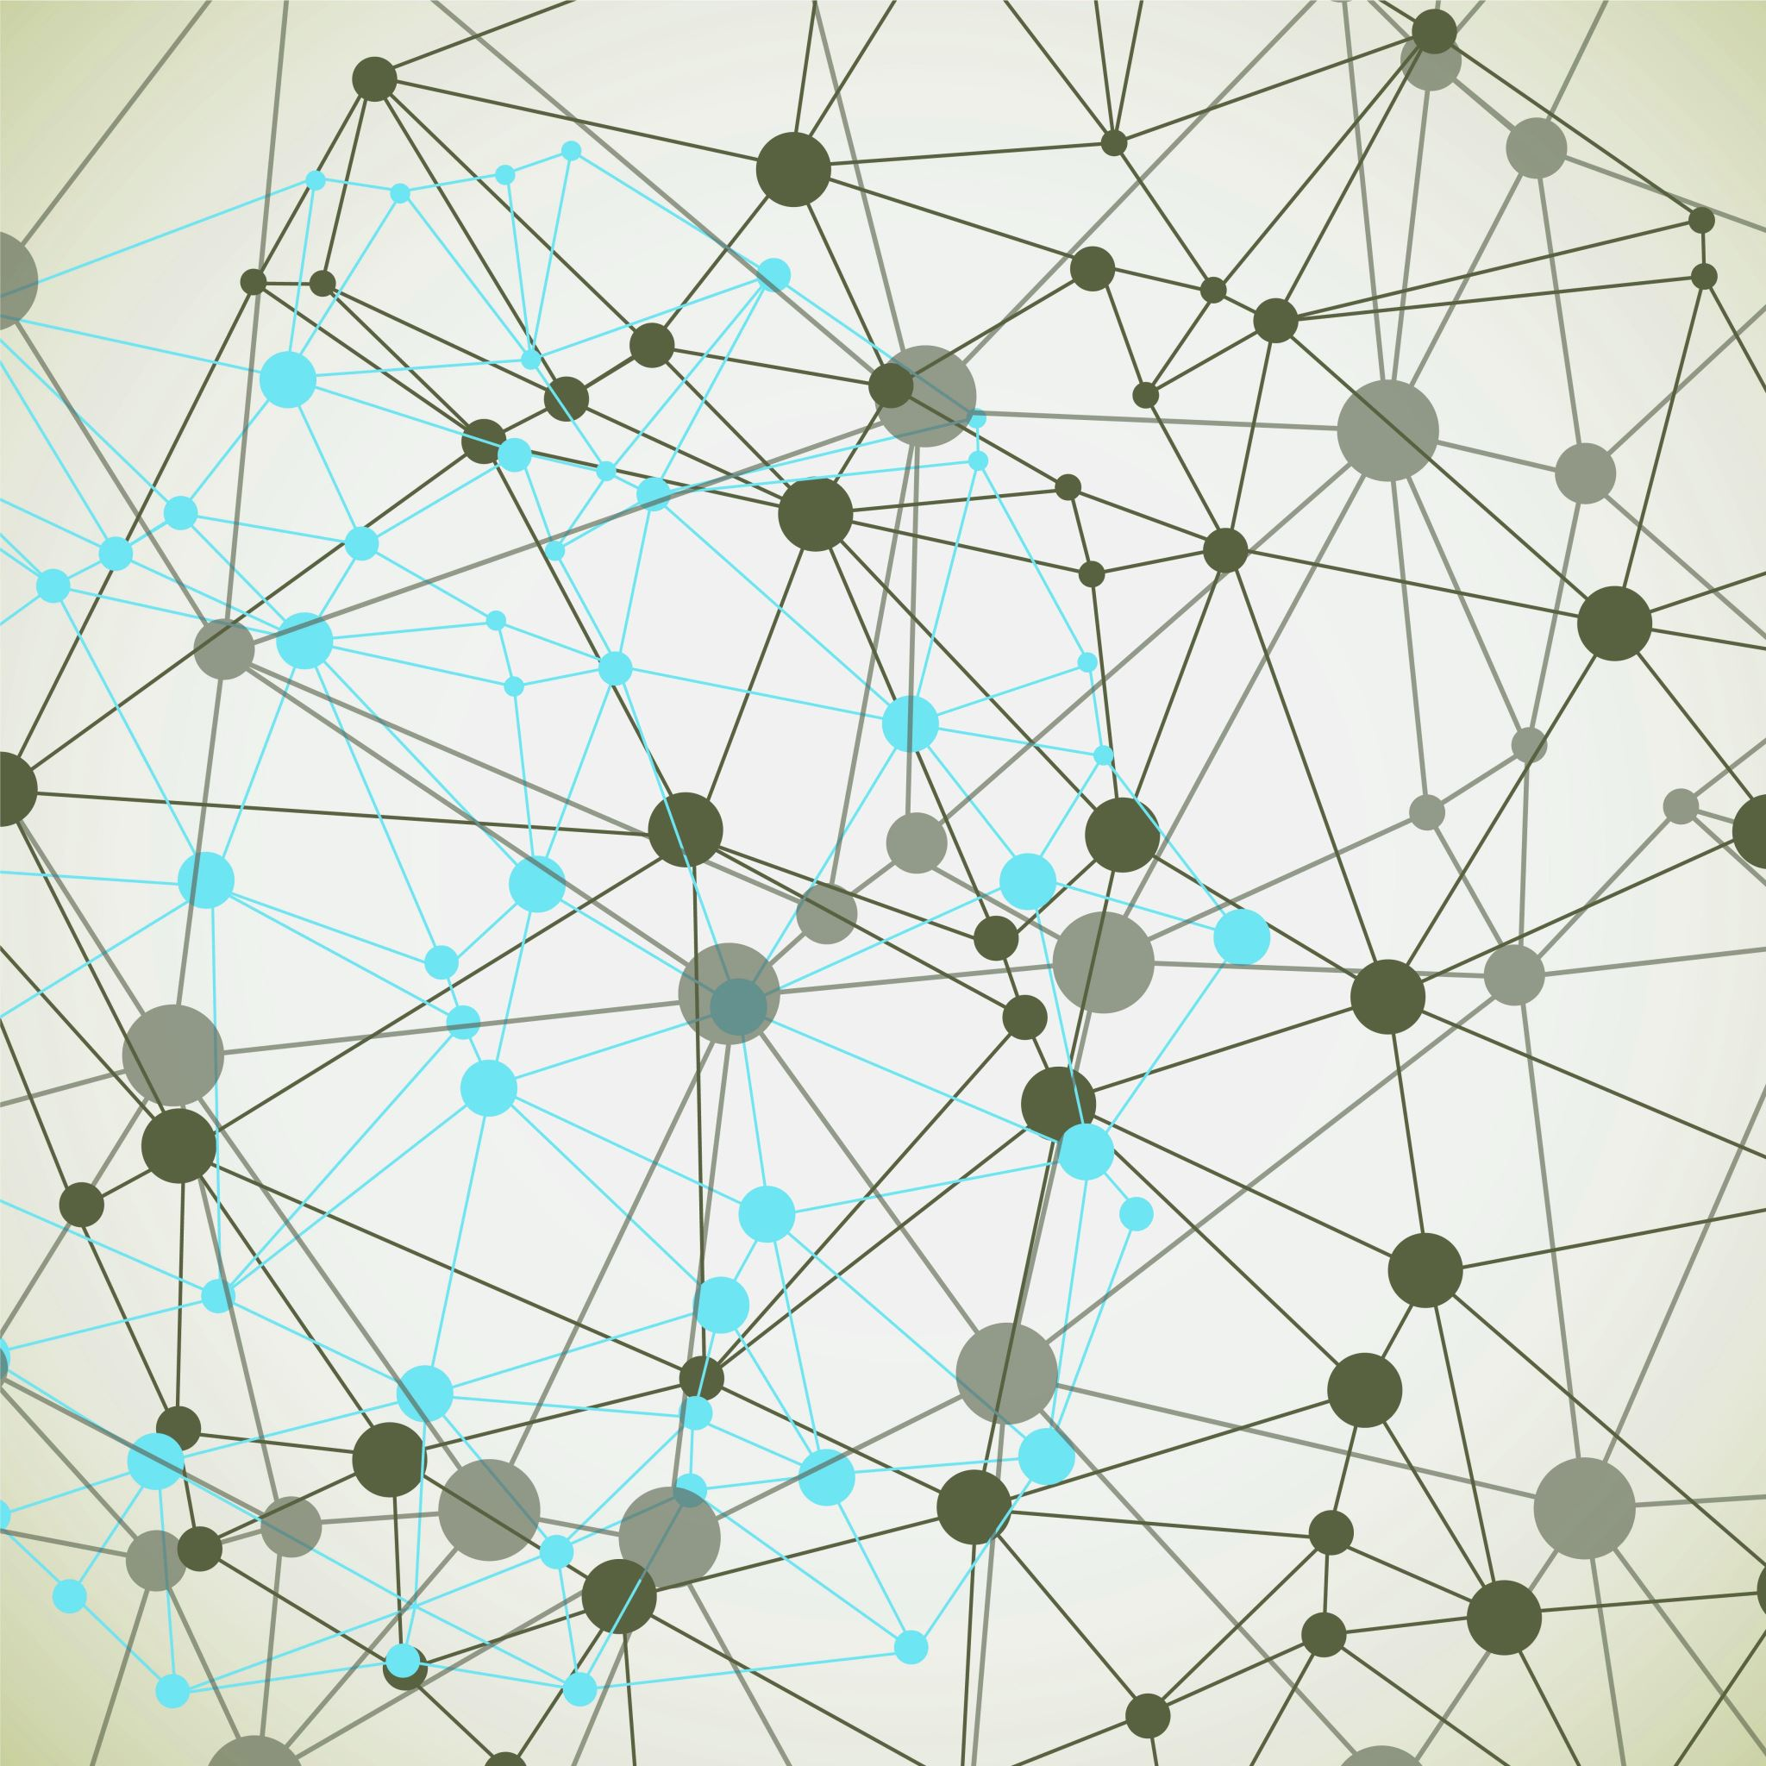
Harsha Simhadri* (Organizer for Track T1/T2), George Williams§ (Organizer for Track T3), Martin Aumüller¤, Matthijs Douze†, Ravishankar Krishnaswamy ^{*+}, Artem Babenko‡, Dmitry Baranchuk‡, Qi Chen*, Lucas Hosseini†, Gopal Srinivasa*, Suhas Jayaram Subramanya#, Jingdong Wang^ *Microsoft Research, §GSI Technology, ¤IT University of Copenhagen, †Meta AI Research, ‡Yandex Labs, #Carnegie Mellon University, ⁺IIT Madras, ^Baidu
Billion-Scale Approximate Nearest Neighbor Search Challenge
https://big-ann-benchmarks.com/
Start: 12:00 (GMT)
[Thanks to Microsoft Research for generous support including Azure credits for participants and organizers]
Notes:
Hi, I am harsha simhadri, and I will give an overview of the billion-scale ANNS challenge. The goal of this competition is encourage the development and understanding of indexing algorithms for ANNS that work at large scales representative of real-world use cases. The organization of this competition is a joint effort between researchers from several researchers from industry and academia. I want to thank for George for organizing the specialized hardware track, Martin for designing the evaluation framework, Matthijs for contributing baselines for tracks T1 and T3 as well as datasets, Ravi for providing baseline for track T2, and Artem, Dmitry, QI, Lucas for providing datasets and Gopal, Suhas and Jingdong for help with organizing. I also want to thank Microsoft Research for generous support in origanizing this competition including Azure credits for participants and organizers.

Slide 2
Overview
Result presentation (12:00—12:45)
Track 1 and 2: Harsha
Track 3: George
Invited Talk by Alexandr Andoni (12:45—13:20) "Learning to Hash Robustly, with Guarantees"
Invited Talk by Anshumali Shrivastava (13:20—13:55) "Iterative Repartitioning for Learning to Hash and the Power of k Choices"
Winner Presentations (13:55—14:30)
T1: KST_ANN_T1
T2: BBANN
T3: OptaNNE GraphNN (Intel), CUANNS MultiGPU (NVIDIA)
Open discussion/future directions (14:30—15:00)

Slide 3
Result Presentation
(12:00—12:45)

Slide 4
Track 1: Limited DRAM. Baseline FAISS on F32v2 VM
F32v2 VM: 32 vCPU, 64GB DRAM
Measure recall@10/AP for the best setting (among 10 submitted) that achieved at least 10,000 QPS
Must submit an entry that works on at least 3 datasets
Winner: kst_ann_t1, Authors: Li Liu, Jin Yu, Guohao Dai, Wei Wu, Yu Qiao, Yu Wang, Lingzhi Liu; Kuaishou Technology and Tsinghua University
Dataset -> | bigann-1B | deep-1B | msspacev-1B | msturing-1B | ssnpp-1B | text2image-1B
Team11 UESTC |  | 0.649 |  | 0.712
puck-t1 CTAD, Baidu | 0.714 | 0.722
ngt-t1 Yahoo! Japan
kst_ann_t1 Kuaishou Tech. Tsinghua Univ. | 0.712 | 0.752 | 0.765 | 0.756
buddy-t1 Silo.AI OpenSource connections | 0.627
Baseline Facebook Research | 0.634 | 0.650 | 0.729 | 0.704 | 0.754 | 0.069
Recall@10 at >10K QPS
Notes:
Power measured using IPMI counters
Cost includes cost of hardware as well as cost of power over 5 year cycle.

Slide 5
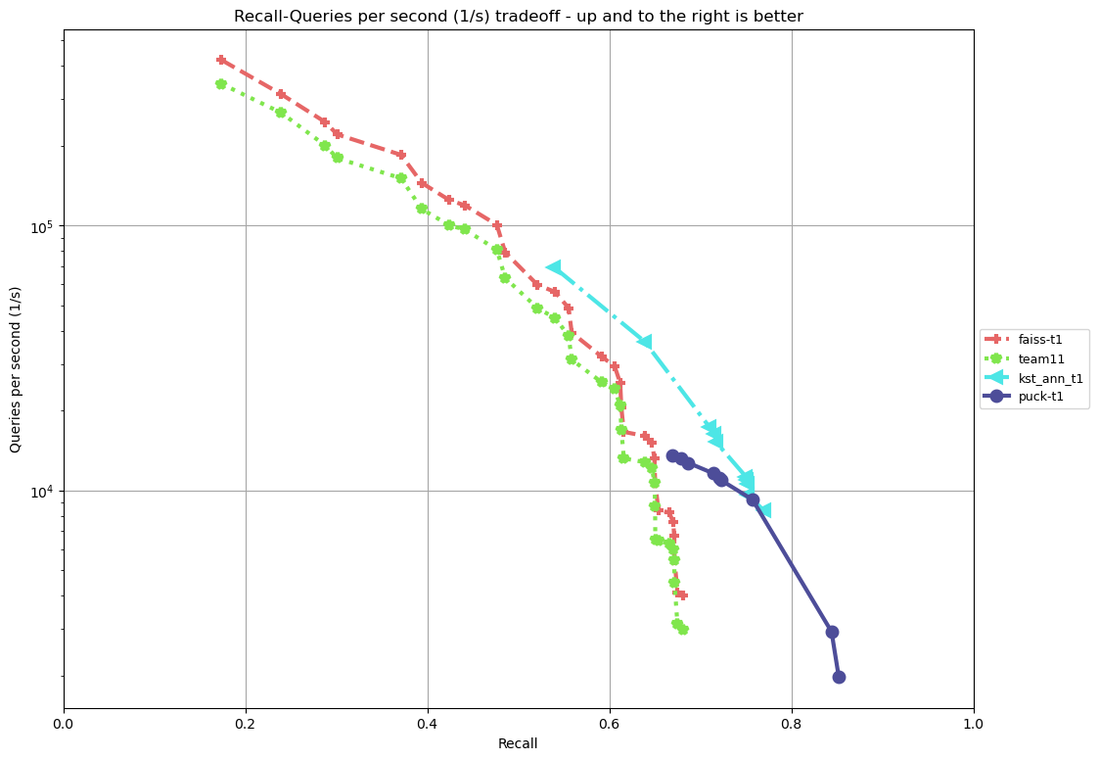
Deep-1B, QPS (y-axis) vs recall@10 (x-axis)

Slide 6
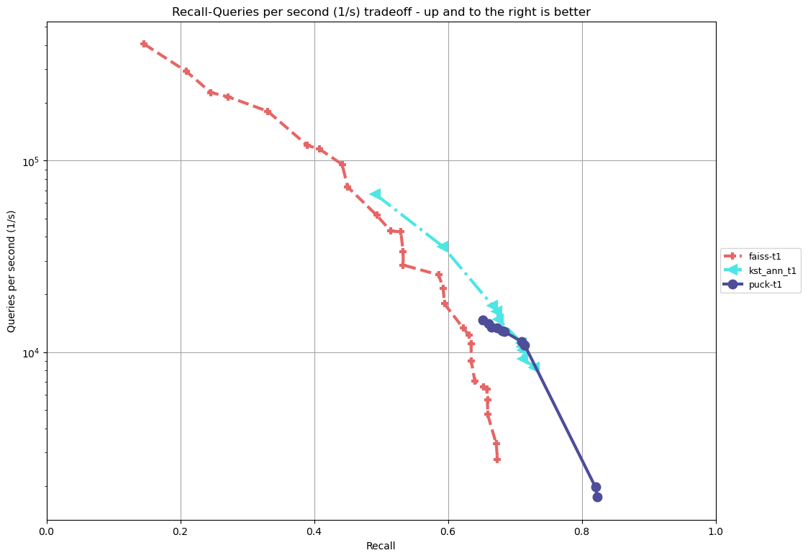
bigann-1B, QPS (y-axis) vs recall@10 (x-axis)

Slide 7
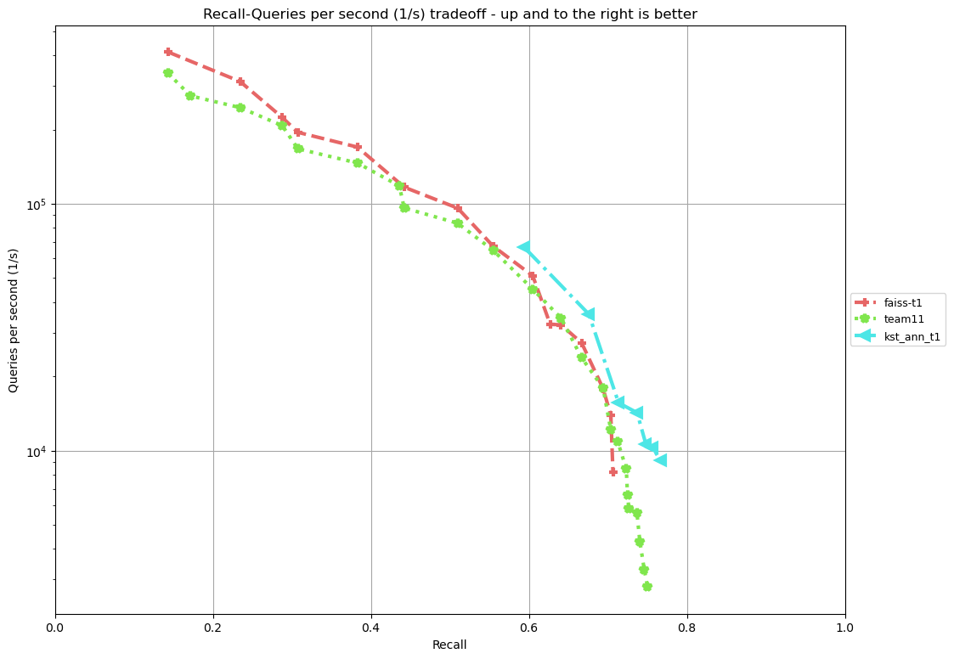
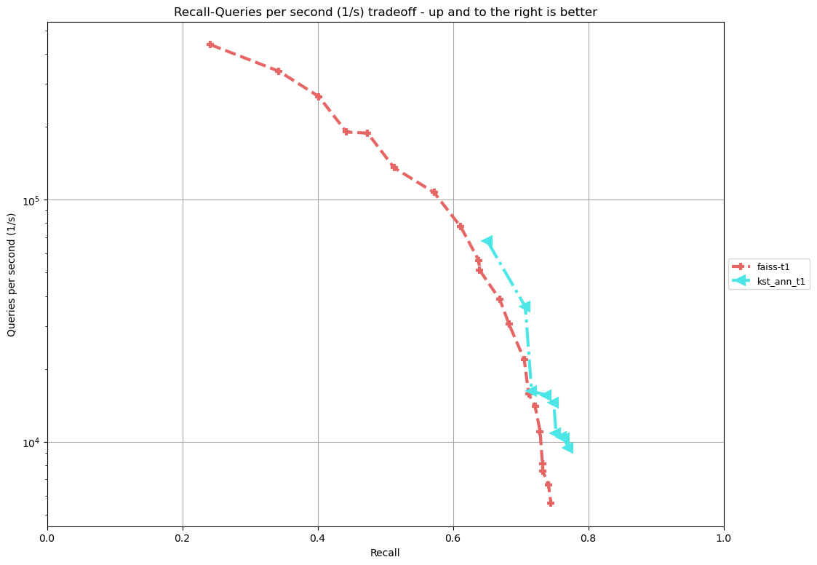
msturing-1B msspacev-1B

Slide 8
Track 2: Limited DRAM + SSD. Baseline DiskANN.
Ls8v2 VM: 8 vCPU, 64GB DRAM
+ 1TB SSD
Measure recall@10/AP for the best setting (among 10 submitted) that achieved at least 1500 QPS
Must submit an entry that works on at least 3 datasets
Winner: bbann, Xiaomeng Yi, Xiaofan Luan, Weizhi Xu, Qianya Cheng, Jigao Luo, Xiangyu Wang, Jiquan Long, Xiao Yan, Zheng Bian, Jiarui Luo, Shengjun Li, Chengming Li, Zilliz and Southern University of Science and Technology
Dataset -> | bigann-1B | deep-1B | msspacev-1B | msturing-1B | ssnpp-1B | text2image-1B
kota-t2 Kwai Tech, Tsinghua Univ | 0.951 |  | 0.904 | 0.940 | 0.182
ngt-t2 Yahoo! Japan
bbann Zilliz SUST |  |  | 0.760 |  | 0.88573 | 0.495
Baseline Microsoft Research India | 0.949 | 0.937 | 0.901 | 0.935 | 0.163 | 0.488
Recall@10/AP at >1500 QPS
Notes:
Kota-t2 built on diskann index, and improved the search algorithm
Bbann came up a new approach to doing range search that was drastically better, but had some performance degradation on bbann.

Slide 9
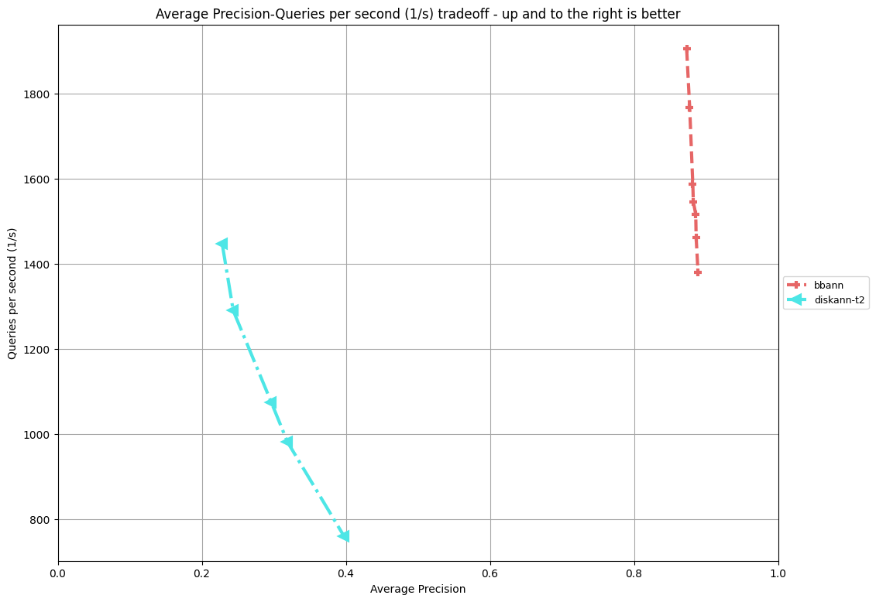
SSNPP-1B, QPS (y-axis) vs AP (x-axis)

Slide 10
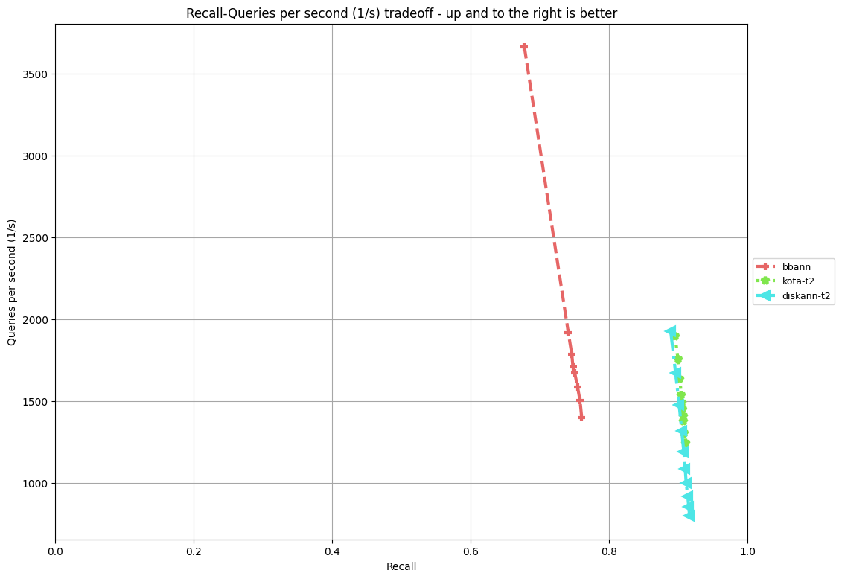
msspacev, QPS (y-axis) vs recall@10 (x-axis)

Slide 11
Track 3: Any hardware. Baseline FAISS on V100 GPU
Use any hardware – bare metal, cloud or custom components/silicon
Better accelerators
Better memory technologies
Baseline: FAISS (IVF1048576,SQ8) on V100 GPU + 700GB DRAM
4 leaderboards
Recall improvements at 2K QPS
QPS improvement at 90% recall
Power
Cost
Dataset | QPS | Recall@10
msturing-1B | 2073 | 0.913
bigann-1B | 2043 | 0.933
text2image-1B | 2149 | 0.860
deep-1B | 2185 | 0.943
msspacev-1B | 3265 | 0.909
Dataset | QPS | Recall@10
msturing-1B | 2845 | 0.902
bigann-1B | 3271 | 0.901
text2image-1B | 1789 | 0.874
deep-1B | 4464 | 0.901
msspacev-1B | 3265 | 0.909
Recall leaderboard
Throughput leaderboard
Notes:
Power measured using IPMI counters
Cost includes cost of hardware as well as cost of power over 5 year cycle.

Slide 12


Track 3: Faiss index "IVF1048576,SQ8” mixed CPU+GPU
IVF1048576 means:
Database vectors are split in 2^20≈1M cells
At search time, the nprobe = say 50 cells closest to the query are searched
This is a speedup of 1M / 50 = 20k over exhaustive search
SQ8 means:
The vectors are represented with 8 bits per component (mild compression, almost no loss in accuracy)
Hardware layout
On GPU: finding the 50 nearest cells to the query vector (because it is a big brute force computation)
On CPU: visiting the 50 cells and comparing to all compressed vectors (because the machine has a lot of RAM)

Slide 13
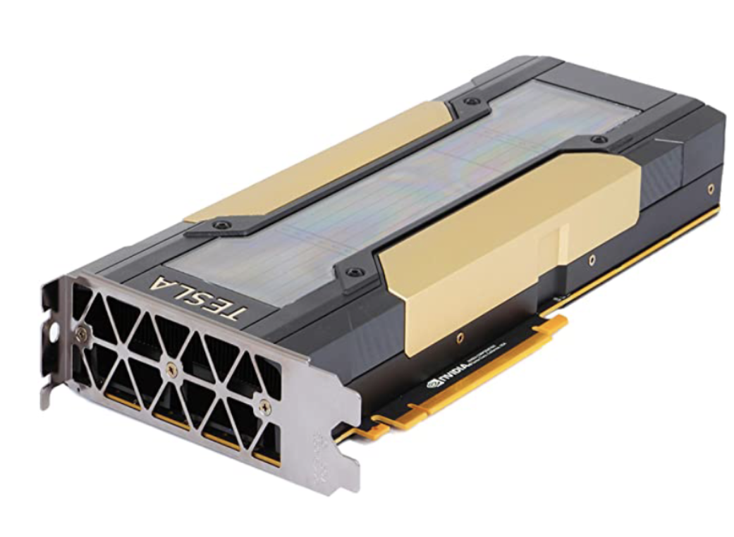
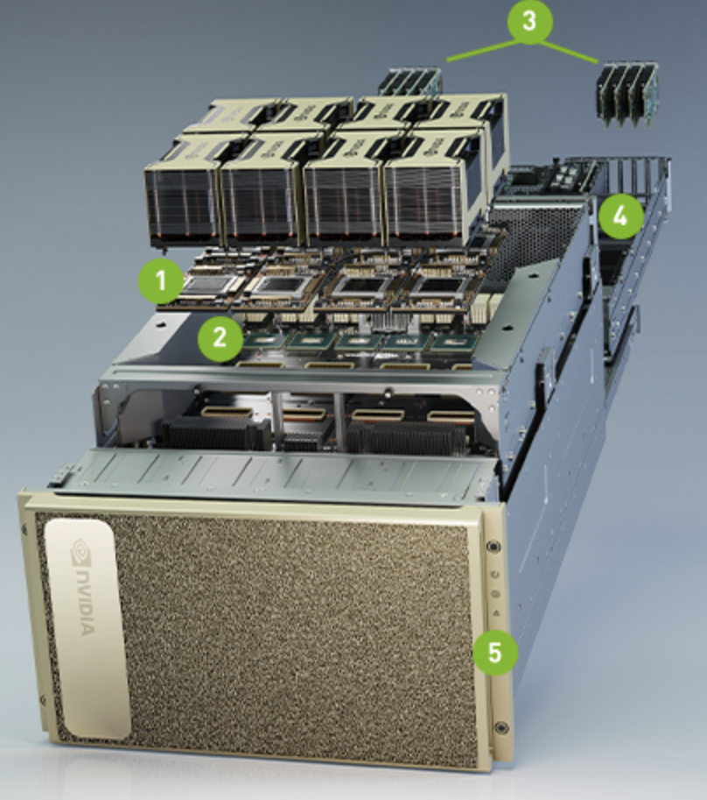
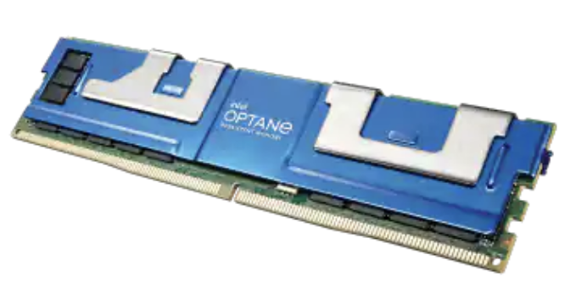
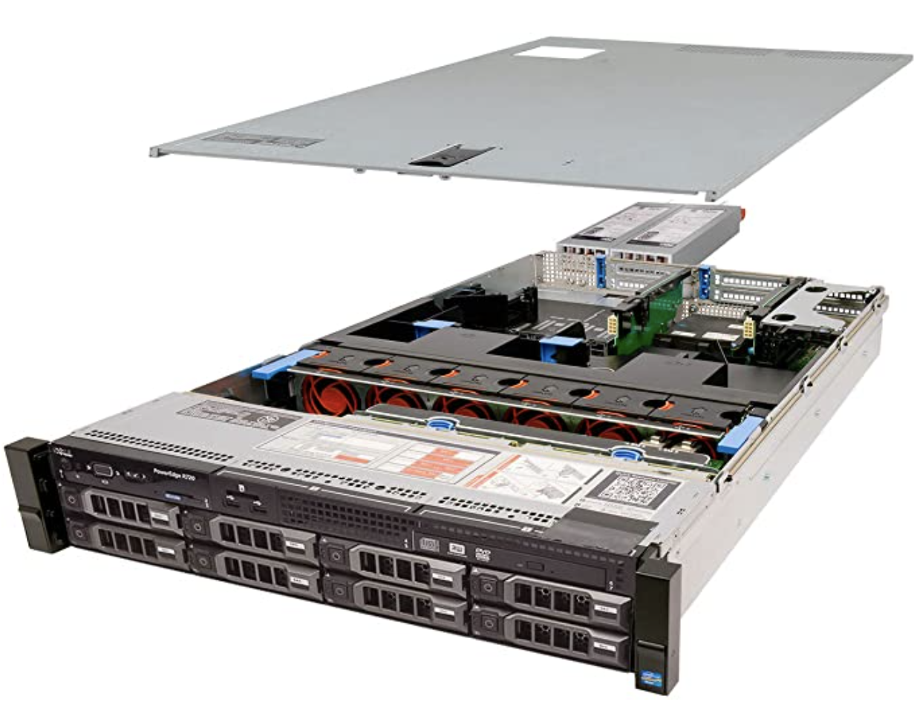
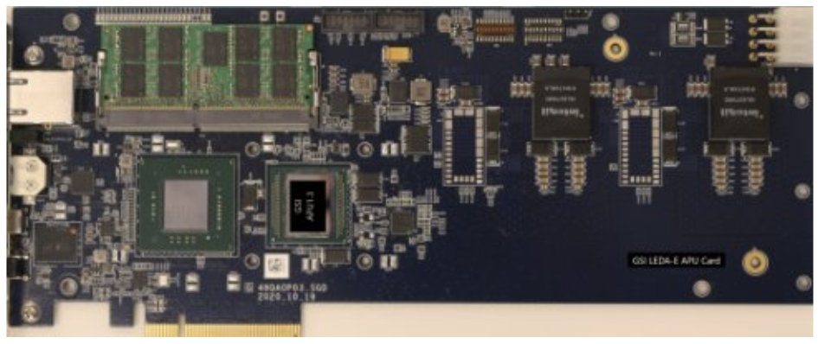
Track 3: The Hardware
Nvidia V100 GPU
Intel Optane
Nvidia DGX A100
GSI Leda-E APU
Dell PowerEdge

Slide 14
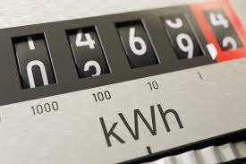
Track 3: Power Benchmark
Power Consumption
kWH/query ( or Watt*seconds/query)
$0.10 / kWh
Power sensors
ipmicap OSS on github
IPMI, DCMI built into motherboards
extended for GPU power

Slide 15
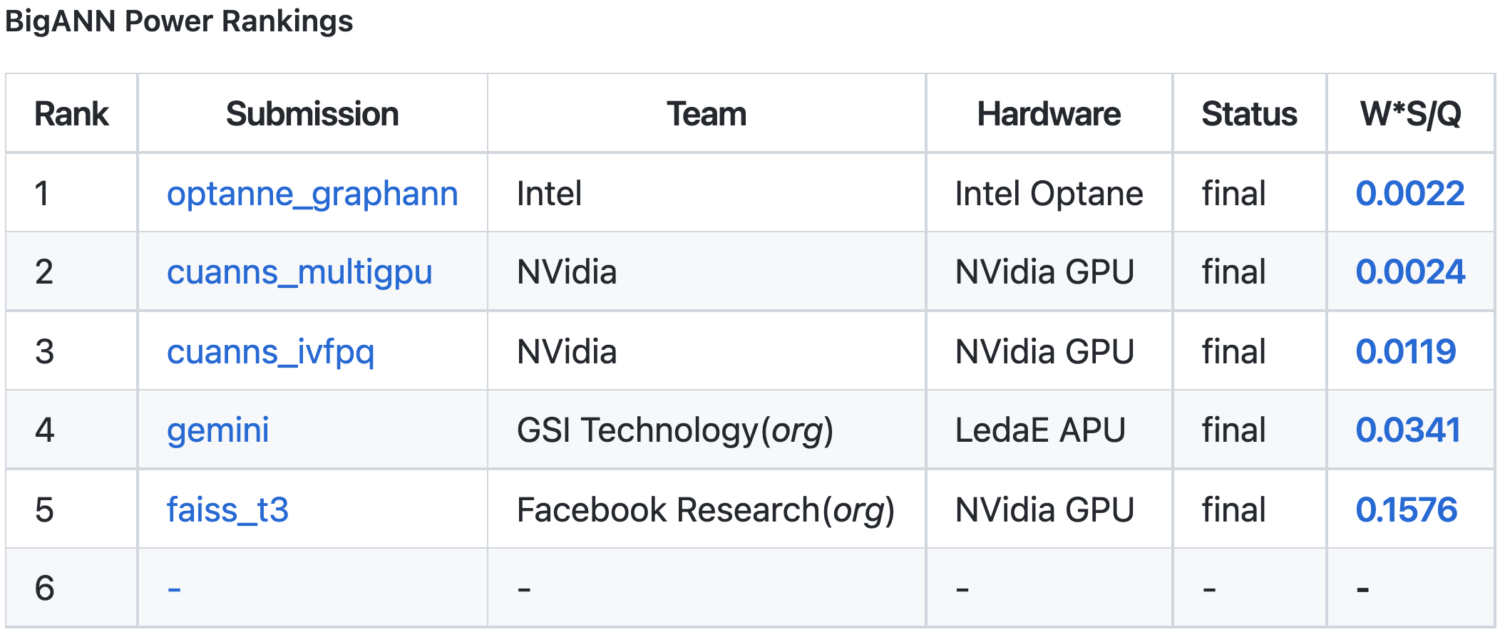
Track 3: Power Benchmark
W*s/query for each dataset
Minimum 90% recall (0.86 for T2I)
In general, higher throughput equates to a lower W*s/query

Slide 16
Track 3: Cost Benchmark
Commercially available HW
MSRP ( invoice/PO )
Intel Optane
(x16) $7200
Nvidia V100 GPU - $9,899
GSI Leda-E APU
$9,995
Nvidia DGX A100
$150K
Dell PowerEdge
$10,817

Slide 17
Track 3: Cost Benchmark
X
Commercially available HW
MSRP ( invoice/PO )
Intel Optane
(x16) $7200
Nvidia V100 GPU - $9,899
GSI Leda-E APU
$9,995
Nvidia DGX A100
$150K
Dell PowerEdge
$10,817

Slide 18
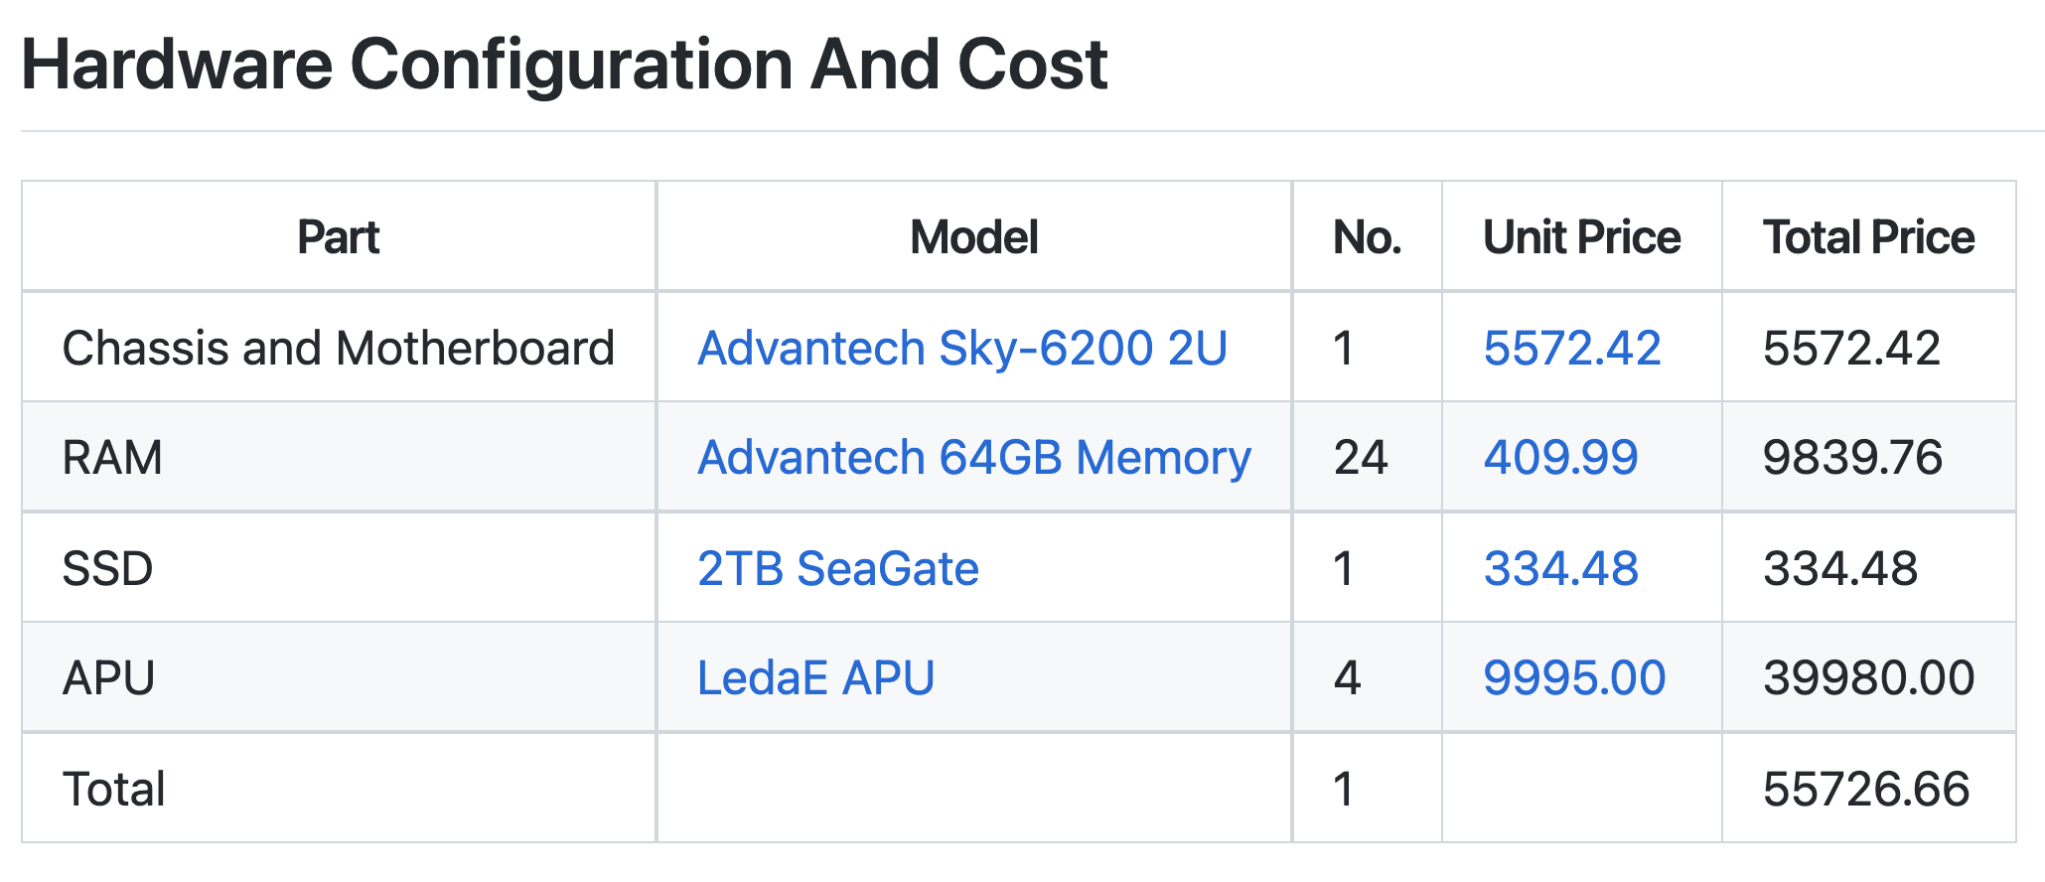
Track 3: Cost Benchmark
"system cost" for apples-to-apples comparison and ranking
Total Cost = Capex + Opex
Add more systems to achieve 100,000 QPS (Capex)
Estimate cost to power them for 4 years (Opex)

Slide 19
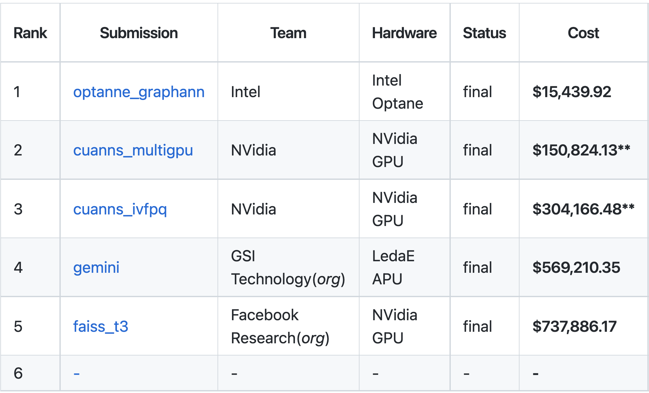
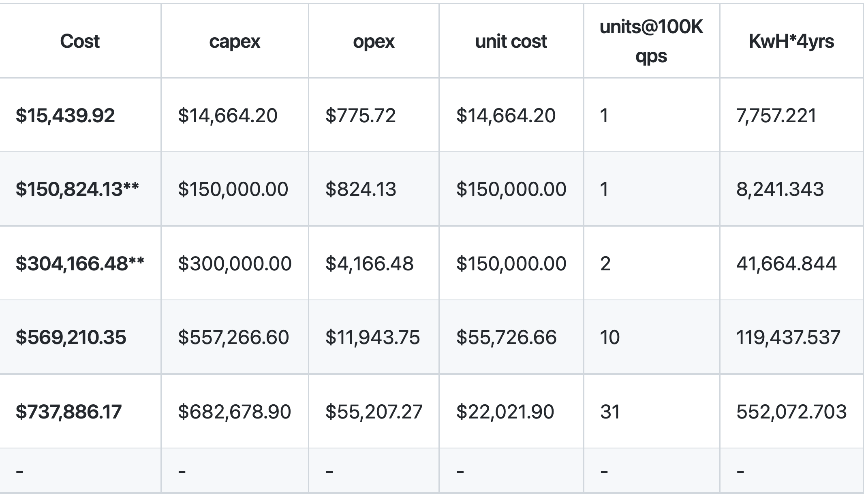

Track 3: Cost Benchmark

Slide 20
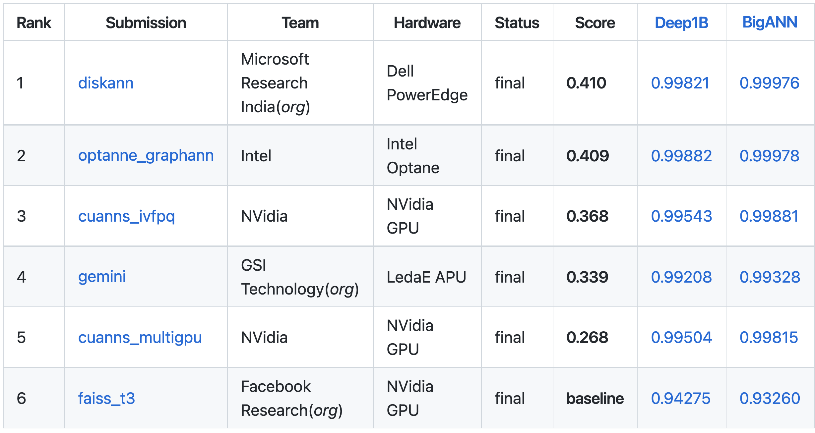
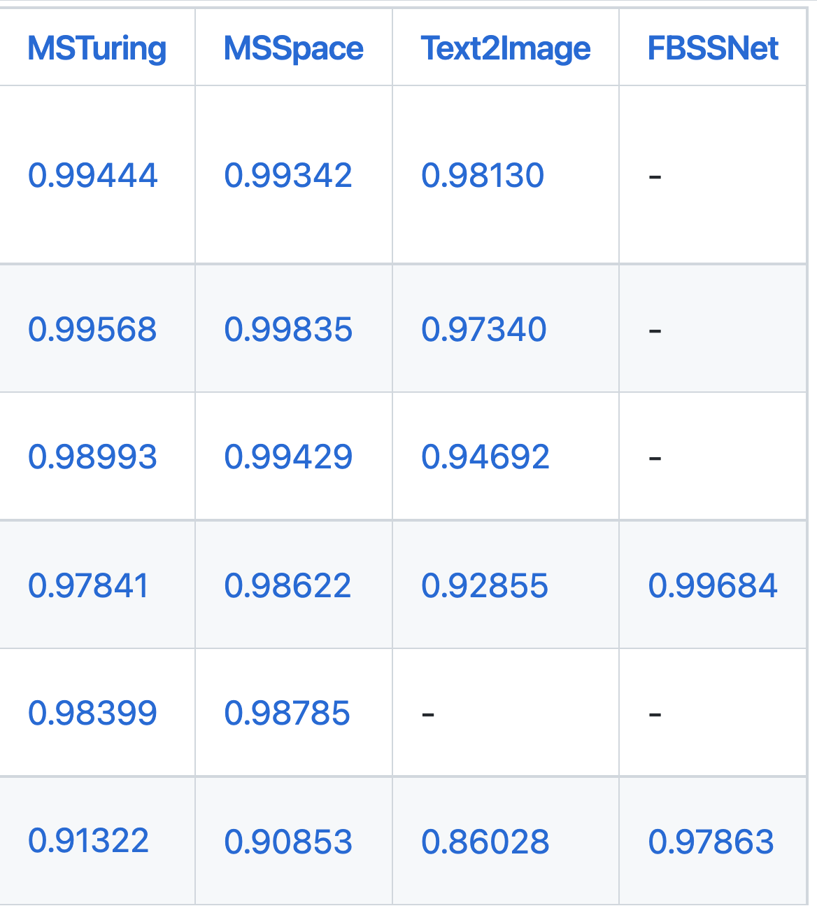

Track 3: Recall Rankings

Slide 21
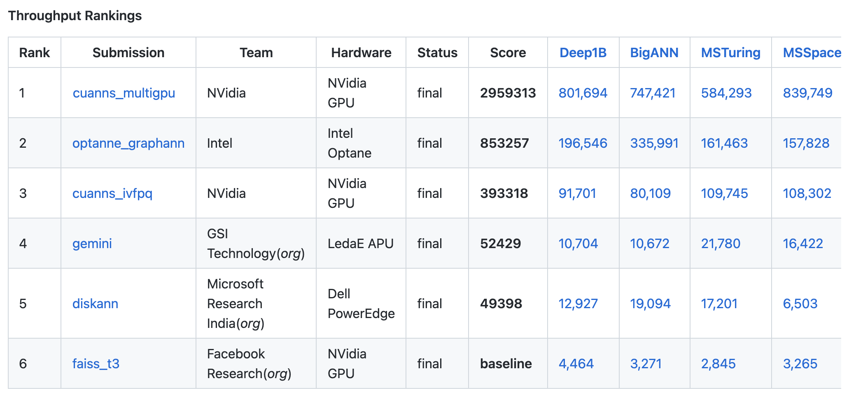
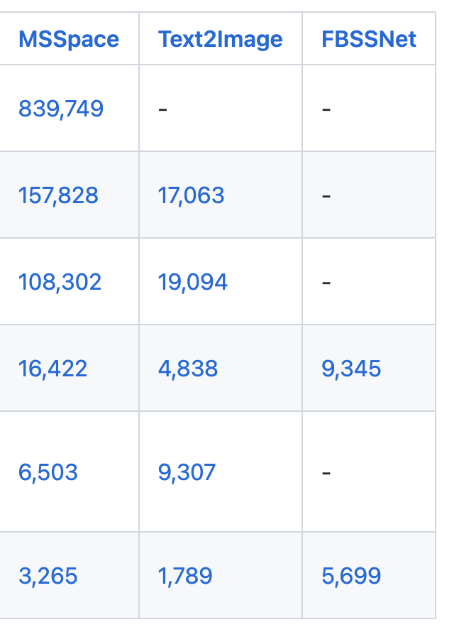
Track 3: Throughput Rankings

Slide 22
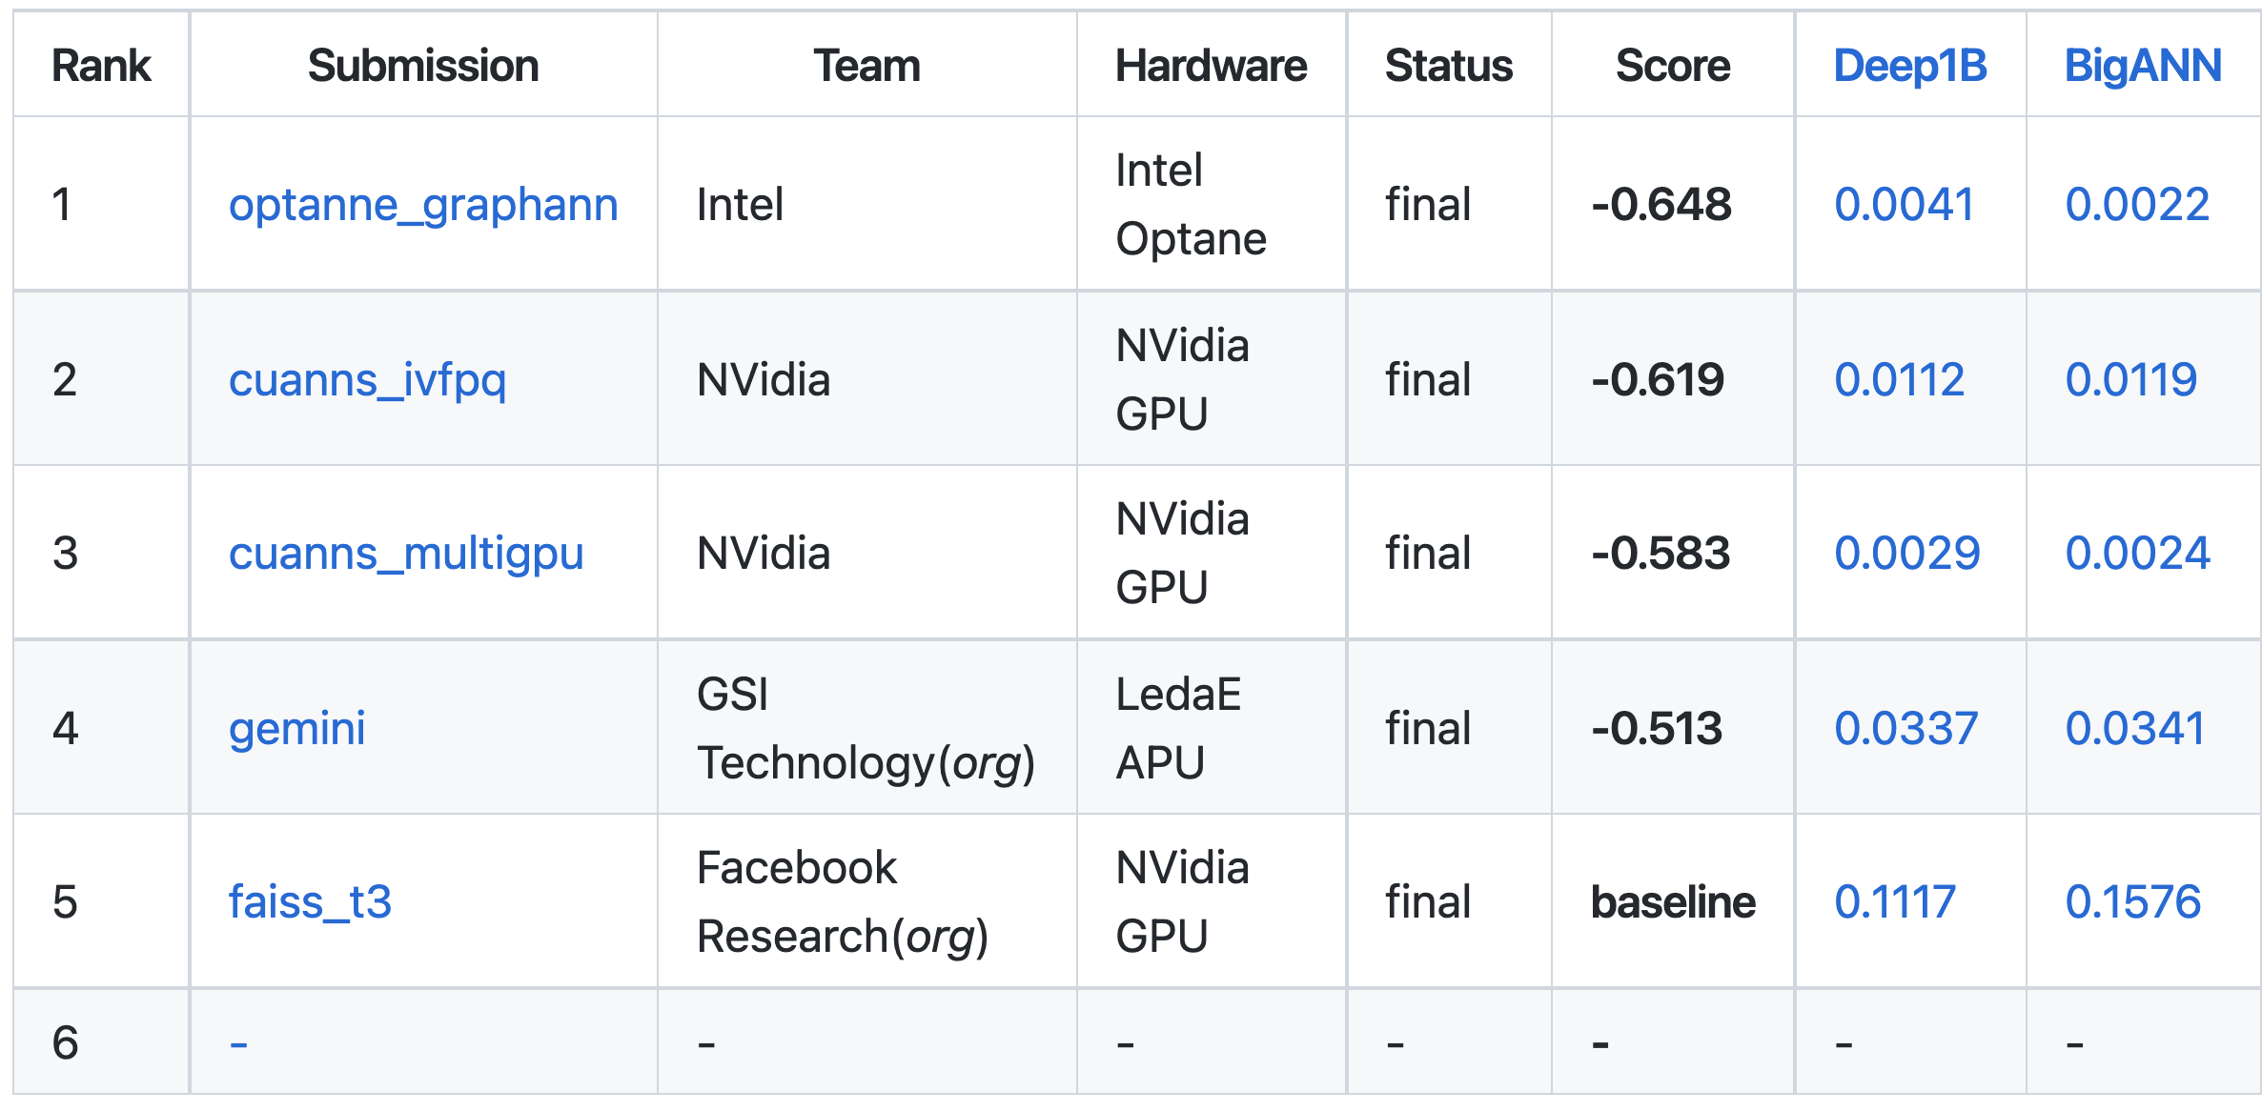
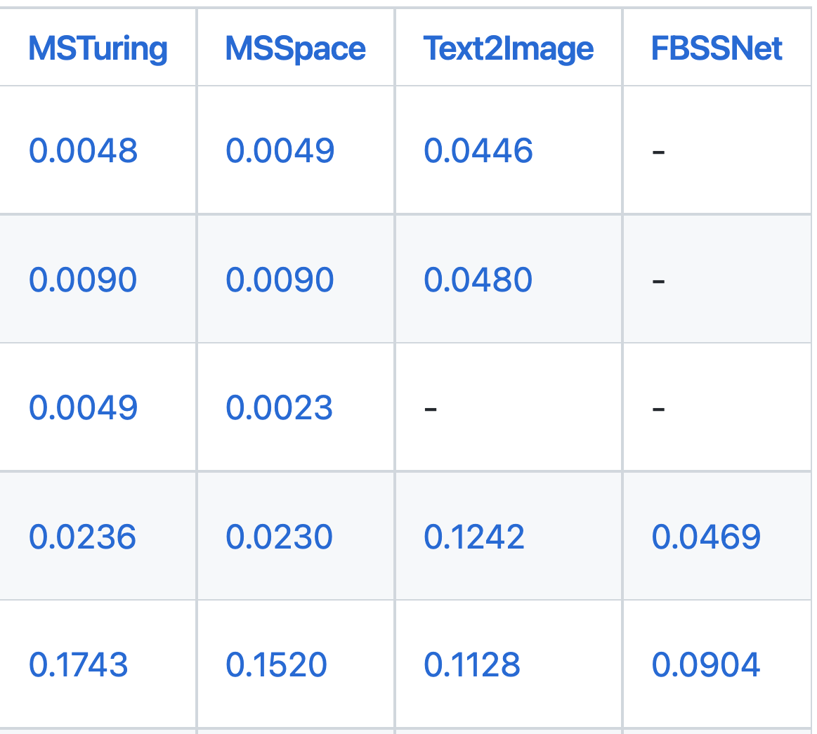
Track 3: Power Rankings

Slide 23
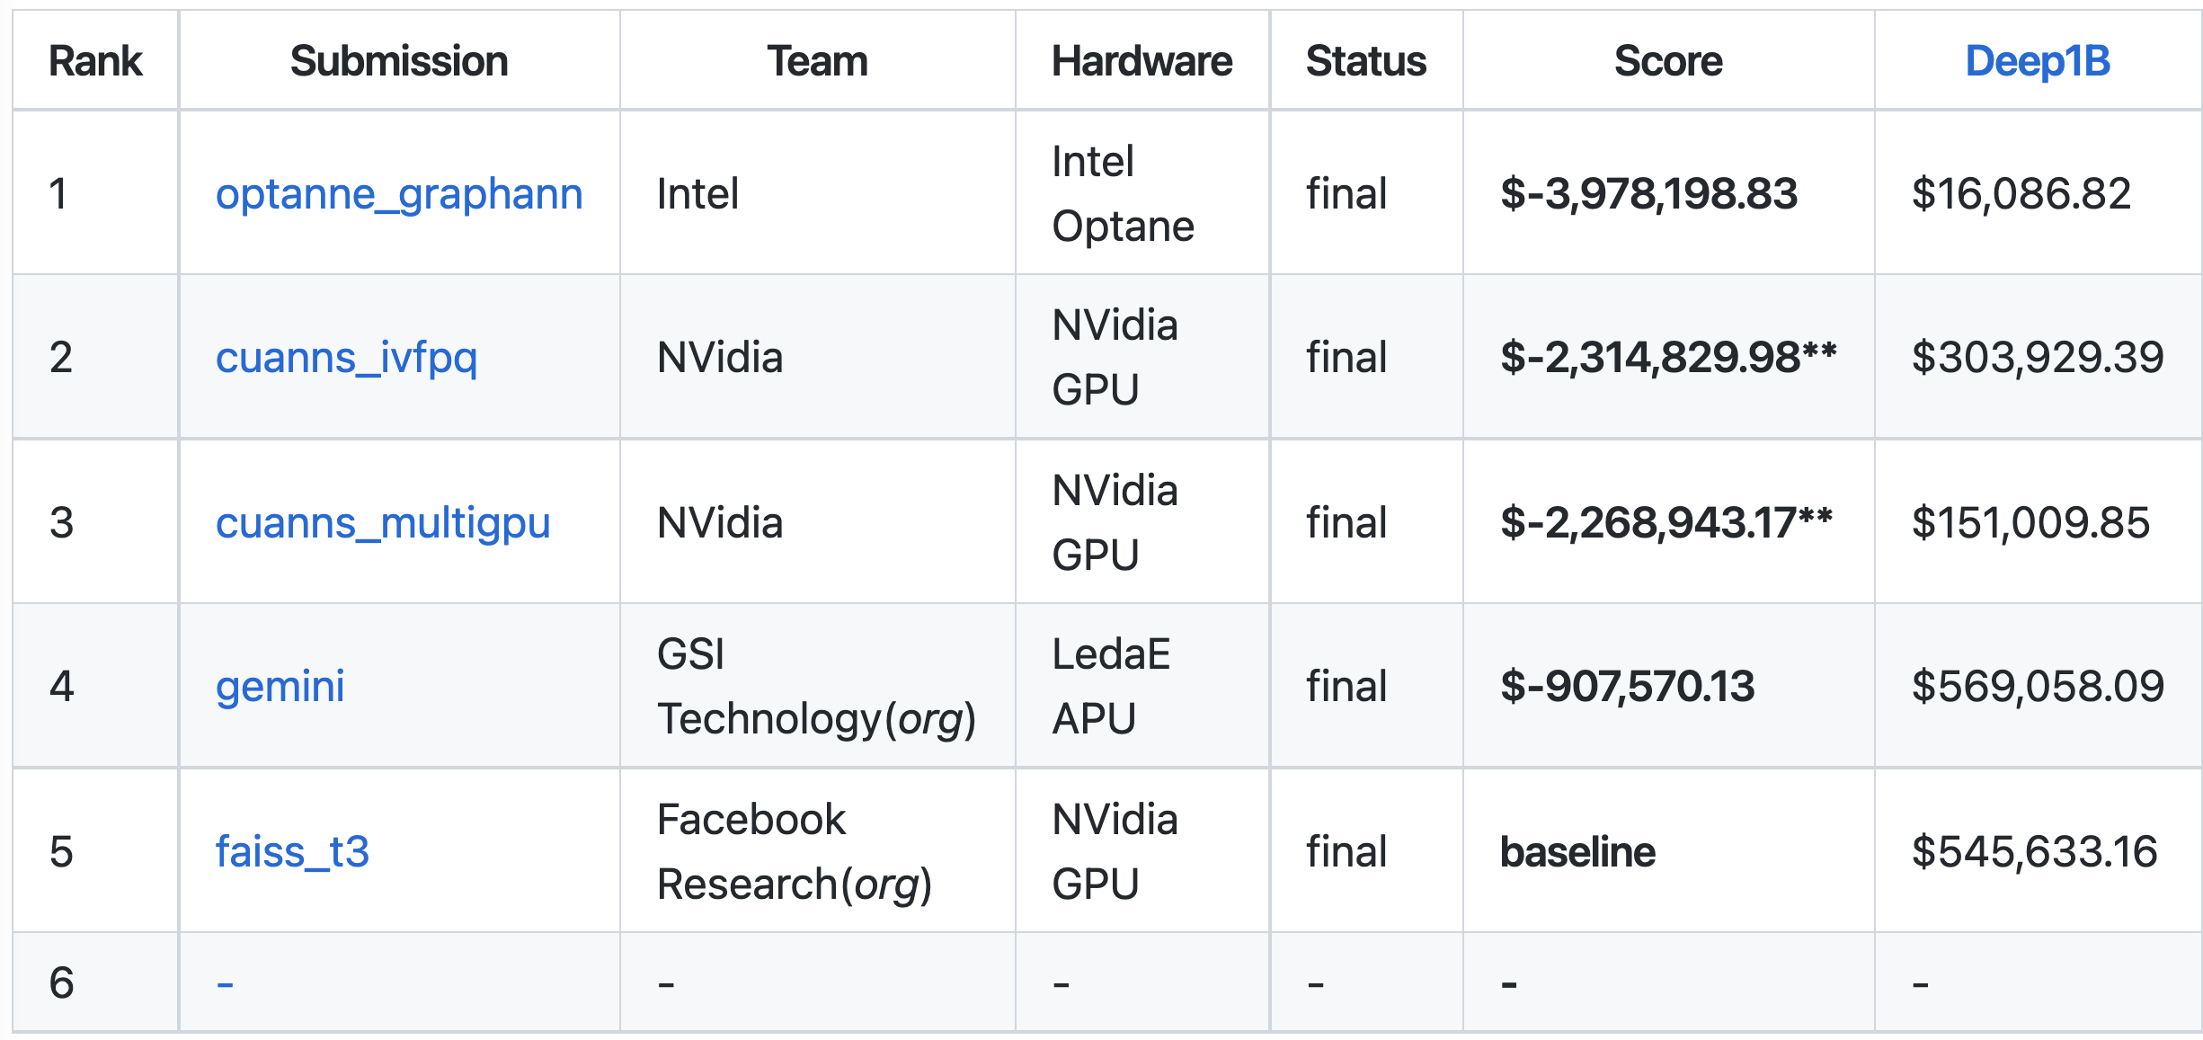
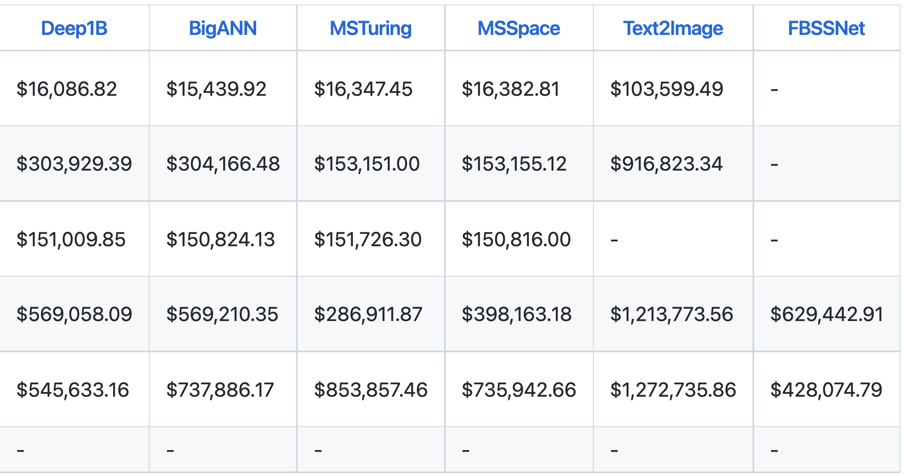
Track 3: Cost Rankings

Slide 24
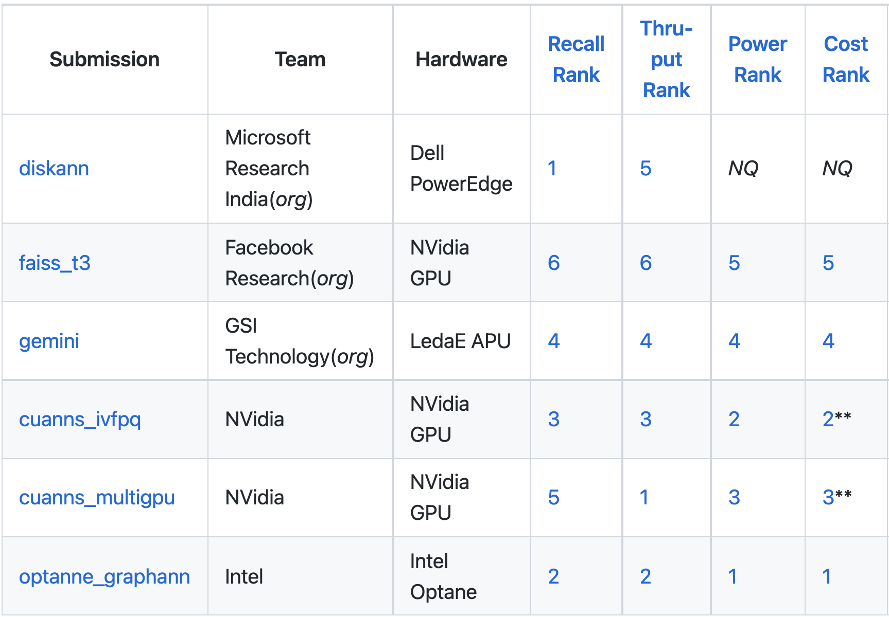
Track 3: All Rankings (public query set)
Competition Winners from
Intel and NVidia
a
Sourabh Dongaonkar (Intel Corporation)
Mark Hildebrand (Intel Corporation / UCD)
Mariano Tepper (Intel Labs)
Cecilia Aguerrebere (Intel Labs)
Ted Willke (Intel Labs)
Jawad Khan (Intel Corporation)
Akira Naruse (NVIDIA)
Jingrong Zhang (NVIDIA),
Mahesh Doijade (NVIDIA)
Yong Wang (NVIDIA)
https://github.com/harsha-simhadri/big-ann-benchmarks/blob/main/t3/LEADERBOARDS.md

Slide 25
Winner Overview
Track 1 (64 GB RAM)
KST_ANN_T1 by Li Liu, Jin Yu, Guohao Dai, Wei Wu, Yu Qiao, Yu Wang, Lingzhi Liu;
Kuaishou Technology and Tsinghua University
Track 2 (64 GB RAM + SSD)
BBANN, Xiaomeng Yi, Xiaofan Luan, Weizhi Xu, Qianya Cheng, Jigao Luo, Xiangyu Wang, Jiquan Long, Xiao Yan, Zheng Bian, Jiarui Luo, Shengjun Li, Chengming Li; Zilliz and Southern University of Science and Technology
Track 3 (No Limits)
OptaNNE GraphNN, Sourabh Dongaonkar (Intel Corporation), Mark Hildebrand (Intel Corporation / UC Davis), Mariano Tepper (Intel Labs), Cecilia Aguerrebere (Intel Labs), Ted Willke (Intel Labs), Jawad Khan (Intel Corporation)
CUANNS MultiGPU, Akira Naruse (NVIDIA), Jingrong Zhang (NVIDIA), Mahesh Doijade (NVIDIA), Yong Wang (NVIDIA), Hui Wang (Xiamen University), Harry Chiang (National Tsing Hua University)

Slide 26
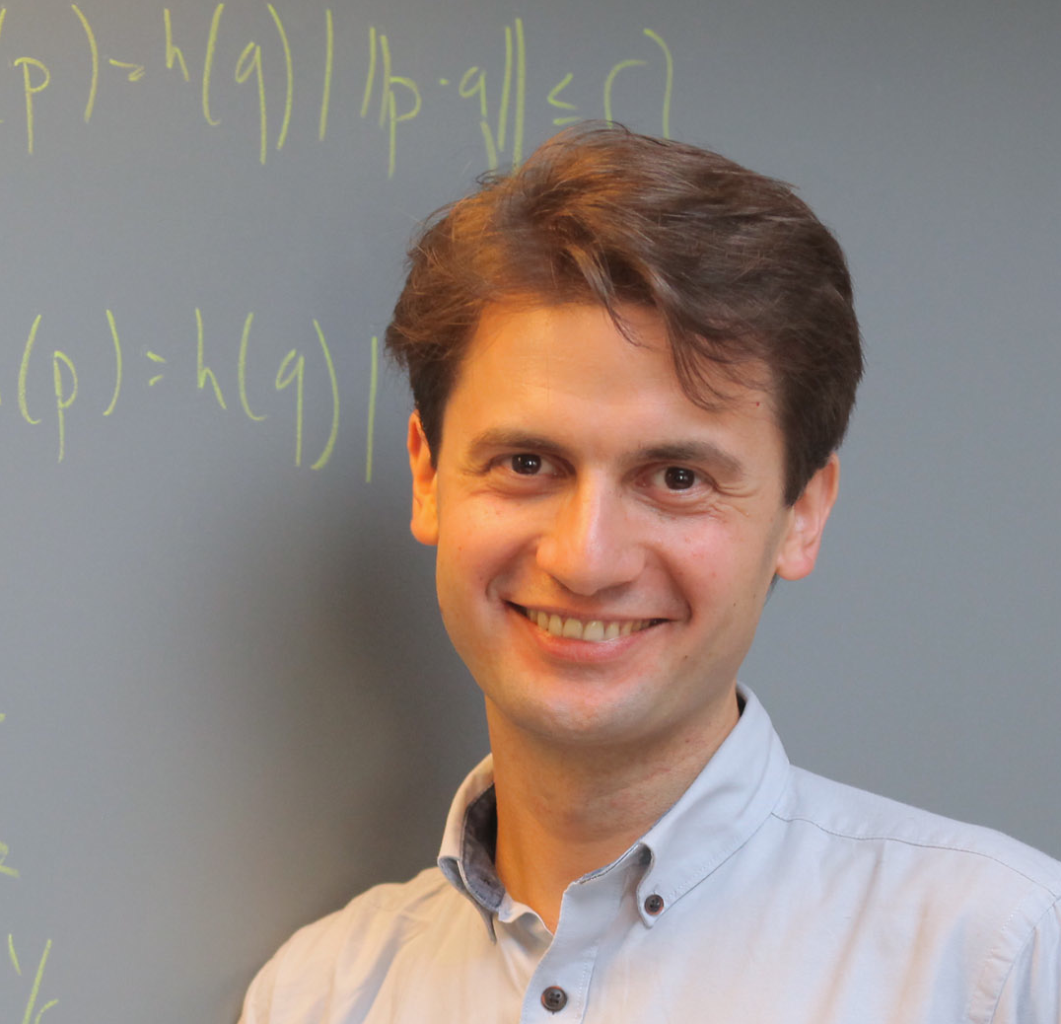
Invited Talk Alexandr Andoni, Columbia University
Learning to Hash Robustly, with Guarantees
(12:45—13:20)

Slide 27
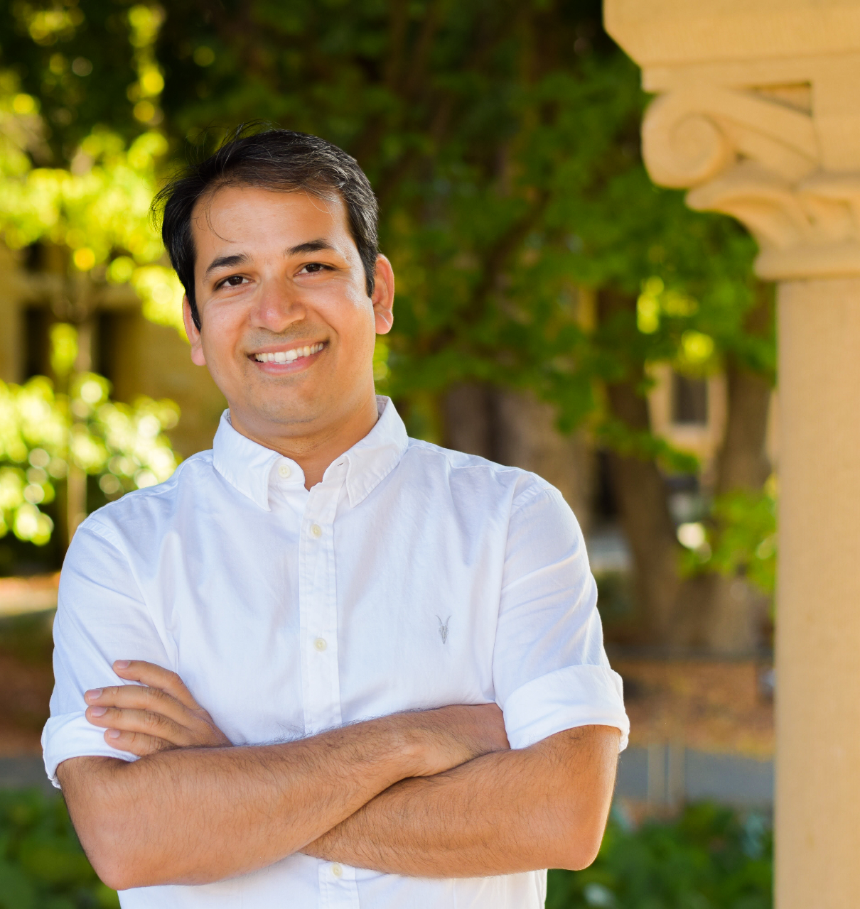
Invited Talk Anshumali Shrivastava, Rice University
Iterative Repartitioning for Learning to Hash and the Power of k Choices
(13:20—13:55)

Slide 28
Winner Presentations
(13:55-14:30)
Track 1 (14:00-14:10)
Track 2 (14:10-14:20)
Track 3 (14:20-14:30)

Slide 29
Open Discussion & Future Directions

Slide 30
The status quo
What worked? What didn't work?

Slide 31
Future directions

Slide 32
Topic 1: Filtered ANNS
Search by attributes + distance, e.g.,
1. Find the best match to this image from Nov 2020
2. Find an email that matches query Q from sender X

Slide 33
Topic 2: Streaming ANNS
Support inserts, deletes in real-time to a billion-scale index without dropping recall, ideally on the same machine that supports search.
Possible baseline: Fresh-DiskANN [https://arxiv.org/abs/2105.09613]

Slide 34
Topic 3: Out of distribution queries
Design index that is better at answering queries arising from a distribution different from the index set, e.g., text queries vs image index, as in Yandex text2image-1B.
To simplify, assume you can use samples of queries to improve indexing.

Slide 35
Topic 4: Better vector compression

Slide 36
Topic 5: From billion-scale to trillion-scale?

